Slide 1

Spotify Unwrapped
A Data Science Exploration by Ryan Freidhoff and Jonah Landas
This Photo by Unknown author is licensed under CC BY-NC-ND.

Slide 2
Overview
Purpose: Discover correlations and unique attributes of data relating to a custom playlist in Spotify.
Structure:
Struggles and Solutions
Introduce the data
Data cleaning
Findings and Visualization
Conclusion

Slide 3
Struggles and Solutions
Struggle: Obtaining the data required a few hours of time due to the data set being custom.
Solution: The solution was to be persistent and change some of the columns originally planned on being in the data set.
Struggle: The read_csv was being used originally and was working. Halfway through analysis, errors were thrown regarding read_csv() being an unknown function.
Solution: The solution was using read.csv() instead and then updating the column names.
Struggle: Date Released column format in .csv file was not compatible with lubridate.
Solution: The solution was reformatting the excel worksheet to a different display of the dates and updating the .csv file version.
Struggle: Some of the artists had characters that are not allowed in r in their name.
Solution: The solution was to alter the name in the .csv file.

Slide 4
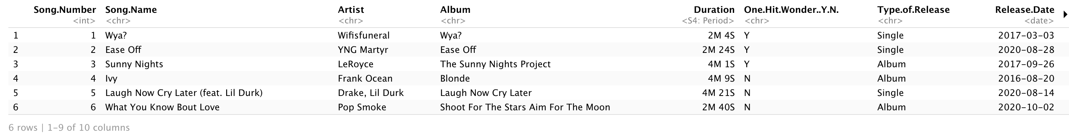
The Data
The data used in this project is entirely homemade. There are 100 rows and 10 columns. The columns are the song number within the playlist, the song name, the artist(s), album name, song duration, if the song is a one-hit-wonder (Y/N), the type of release (album, single, EP), release date, monthly listeners of the artist and the number of plays of the song.

Slide 5
Data Cleaning
The data contained no missing entries as it was hand-made. Cleaning the data consisted of reformatting in the following processes:
Read the .csv file into a data frame named `spotify`
Add a calculated column `Plays.Listener.Ratio` which is the ratio of the number of plays and the monthly listeners
Reformatting the release date column using lubridate package
Reformatting the song duration column using lubridate package

Slide 6
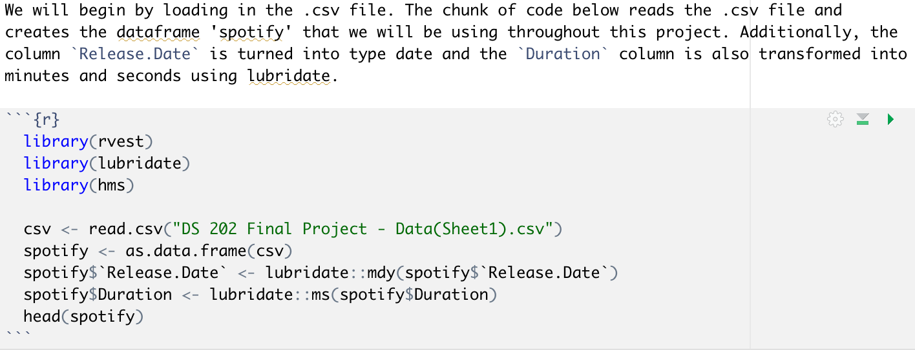
Data Cleaning - Code

Slide 7
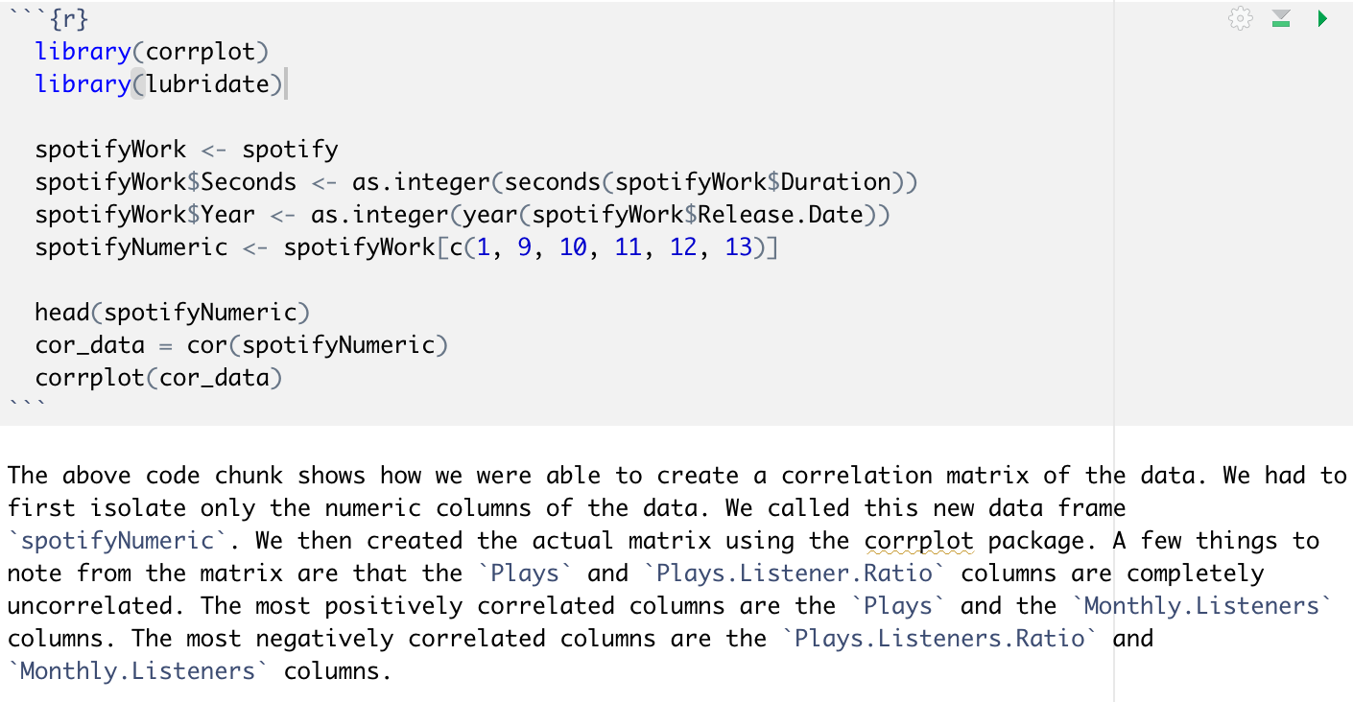
Findings and Visualization
The first idea was to find the correlations between each of the numeric columns. We first had to change duration to seconds, and we also added a year column. The code for this process is shown on the right.

Slide 8
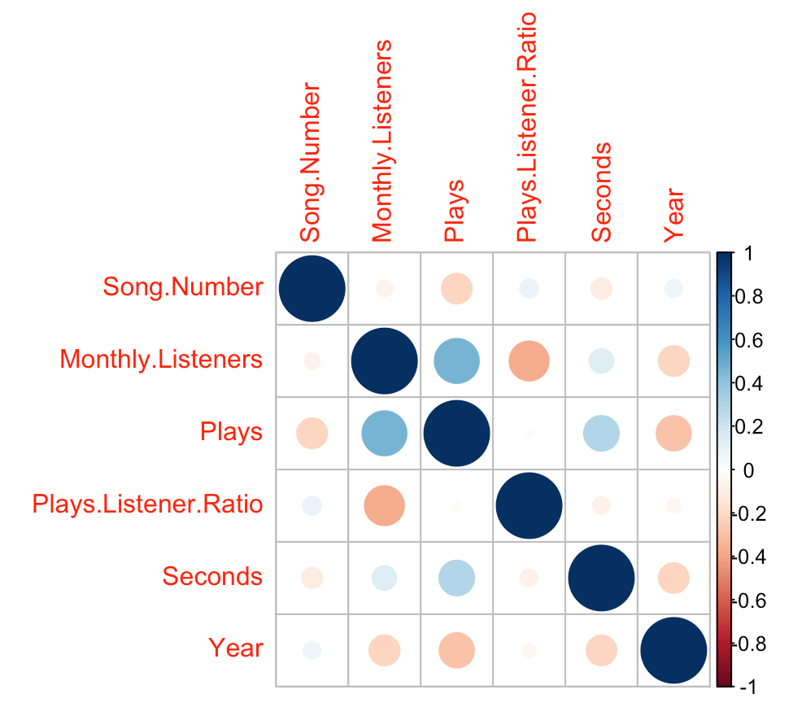
Findings and Visualization
The correlation matrix is displayed using the corrplot package to the right. We can see that the `Plays.Listener.Ratio` column and the `Plays` column have no correlation. Also of interest is the moderate positive correlation between `Plays` and `Monthly.Listeners`.

Slide 9
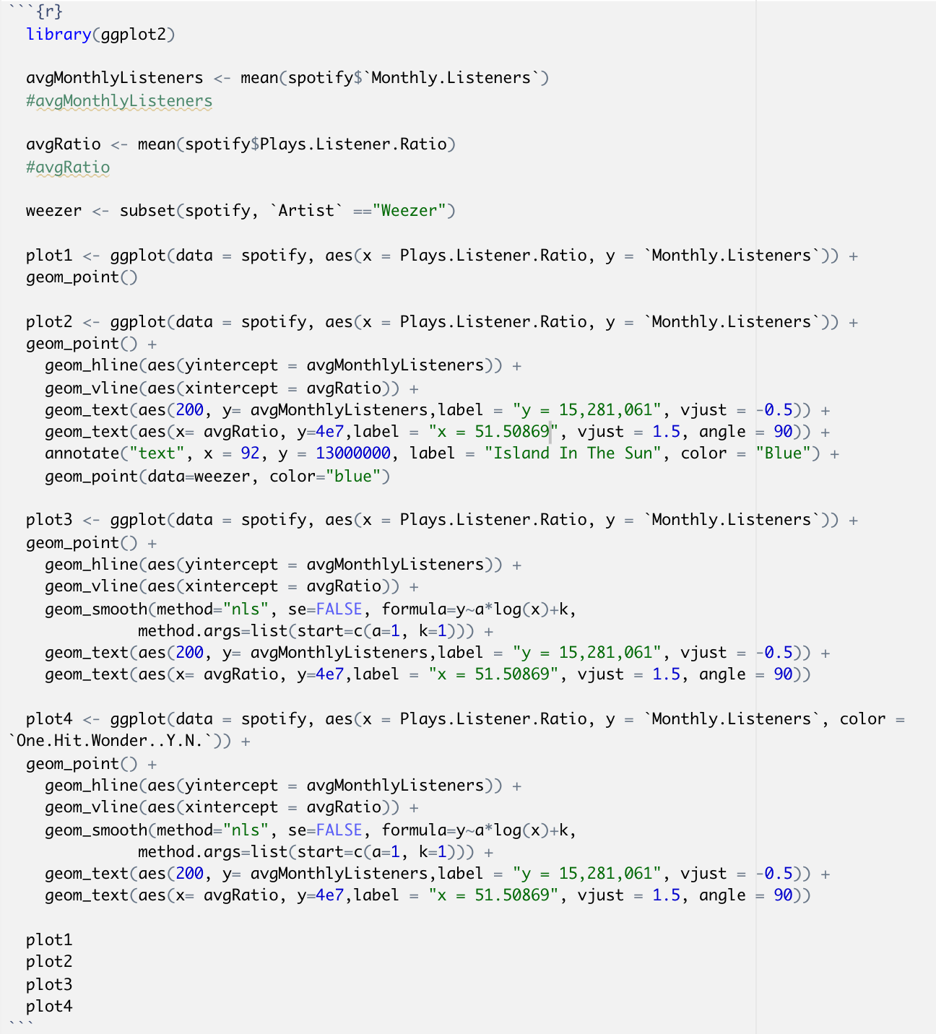
Findings and Visualization
The next bit of exploration was done by creating a scatter plot of the `Plays.Listener.Ratio` and the `Monthly.Listeners`. All graphing was done using the ggplot2 package and the code is displayed on the right.

Slide 10
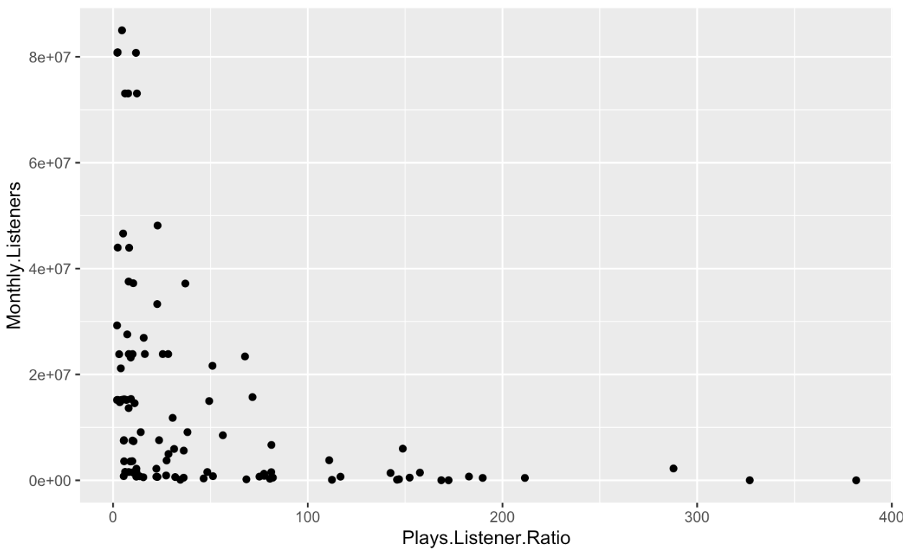
Findings and Visualization
To the left is the initial scatter plot of the ratio versus the monthly listeners. We will now investigate further by adding horizontal and vertical lines at the average ratio and the average number of plays.

Slide 11
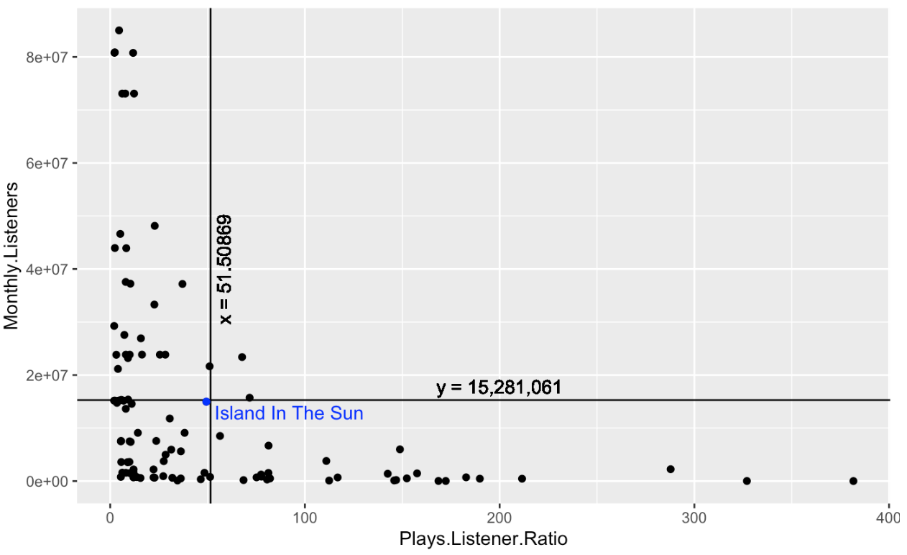
Findings and Visualization
We have now added the labeled lines that show the average value of each metric. Additionally, we have emphasized the song closest to the average of both metrics. Interestingly, 'Island In The Sun' is the oldest song by far in the playlist and is in a different genre than most others.

Slide 12
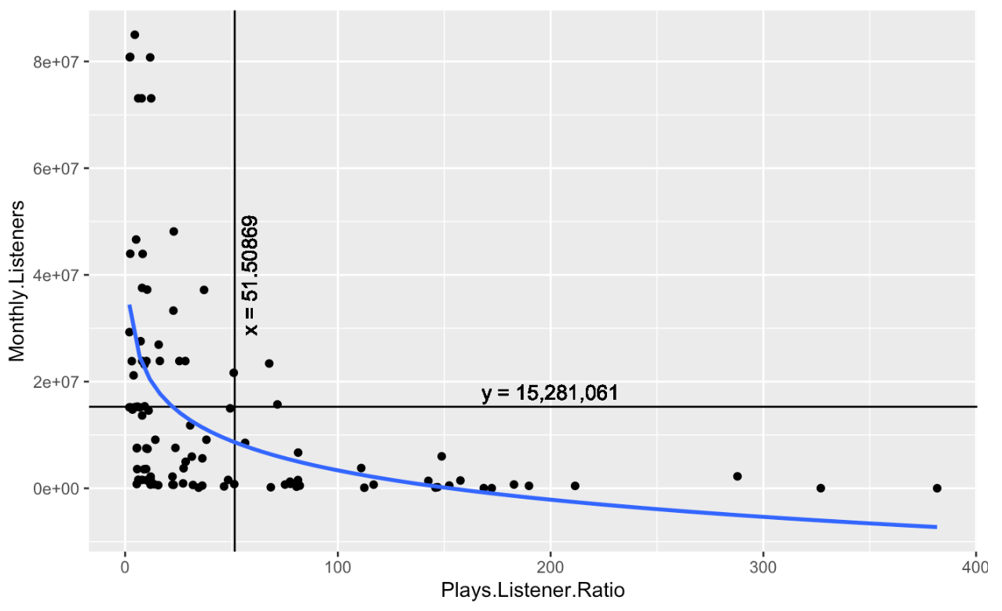
Findings and Visualization
The data set seems to be logarithmic in nature. To test this, we have added a logarithmic fit function in blue using the geom_smooth() function in the ggplot2 package.

Slide 13
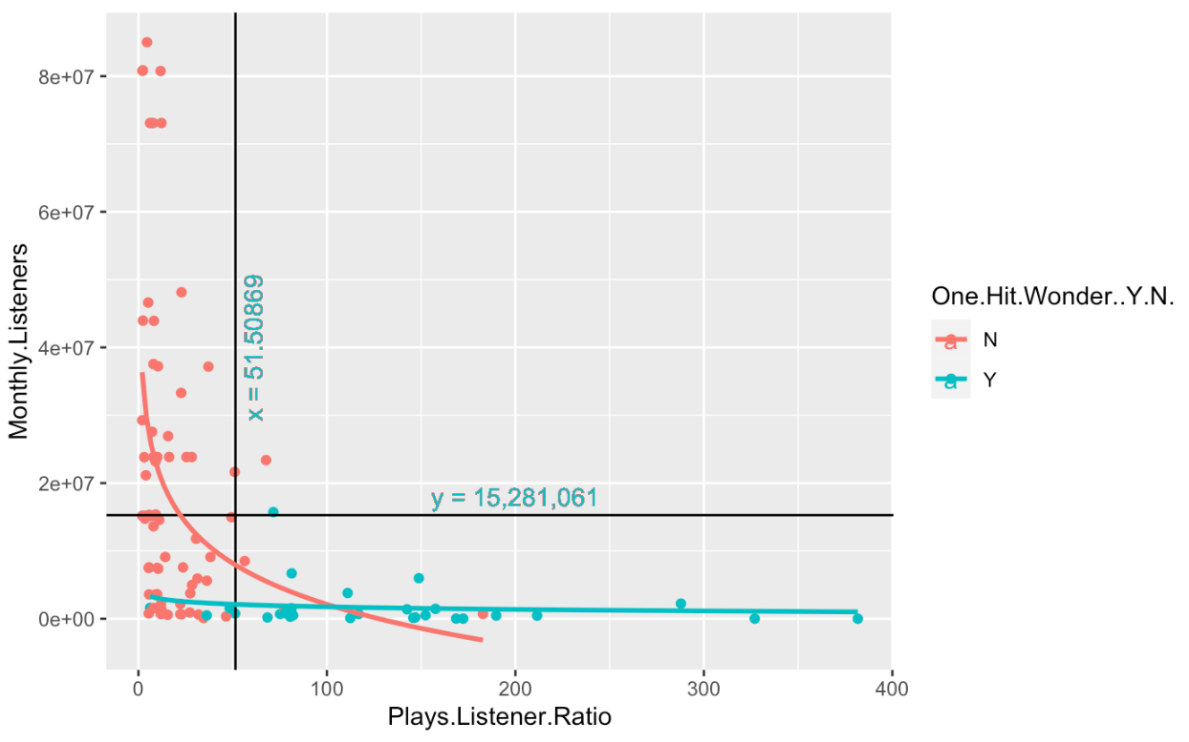
Findings and Visualization
We then investigated what the one-hit-wonder column had to do with where each song falls on the plot. As seen, the logarithmic fit only holds for the songs that are not one hit wonders.

Slide 14
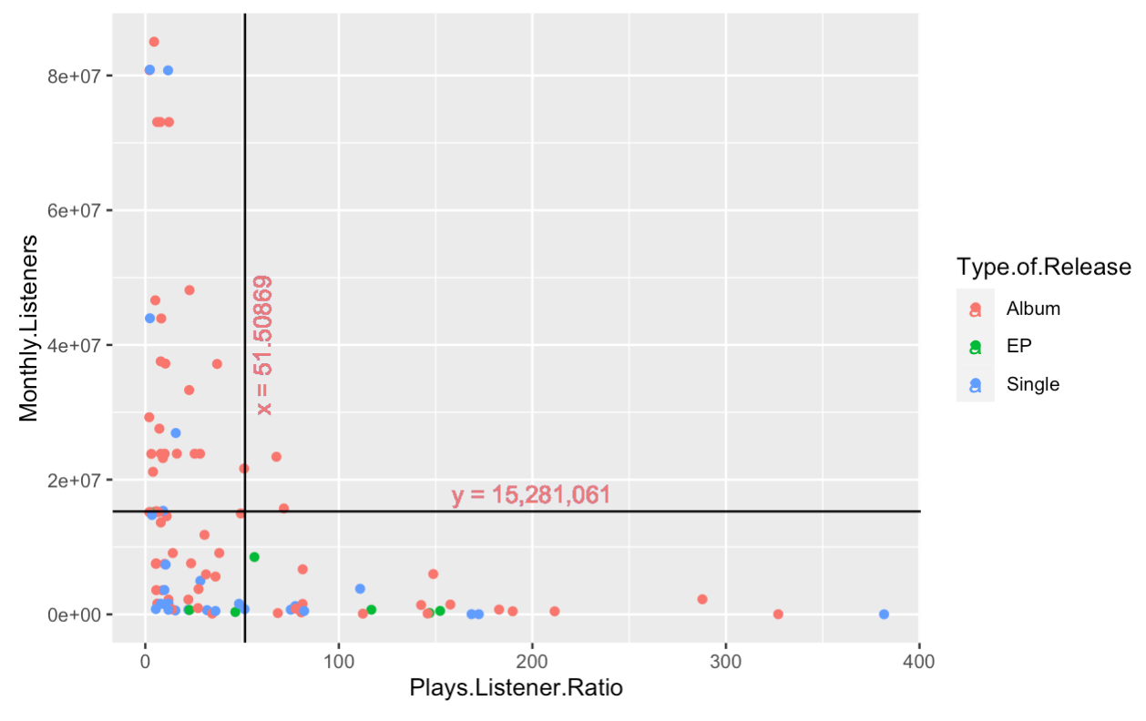
Findings and Visualization
Next, we colored the plot based on the type of release. As seen in the plot, a majority of the songs are in albums and only a handful are in EPs.

Slide 15
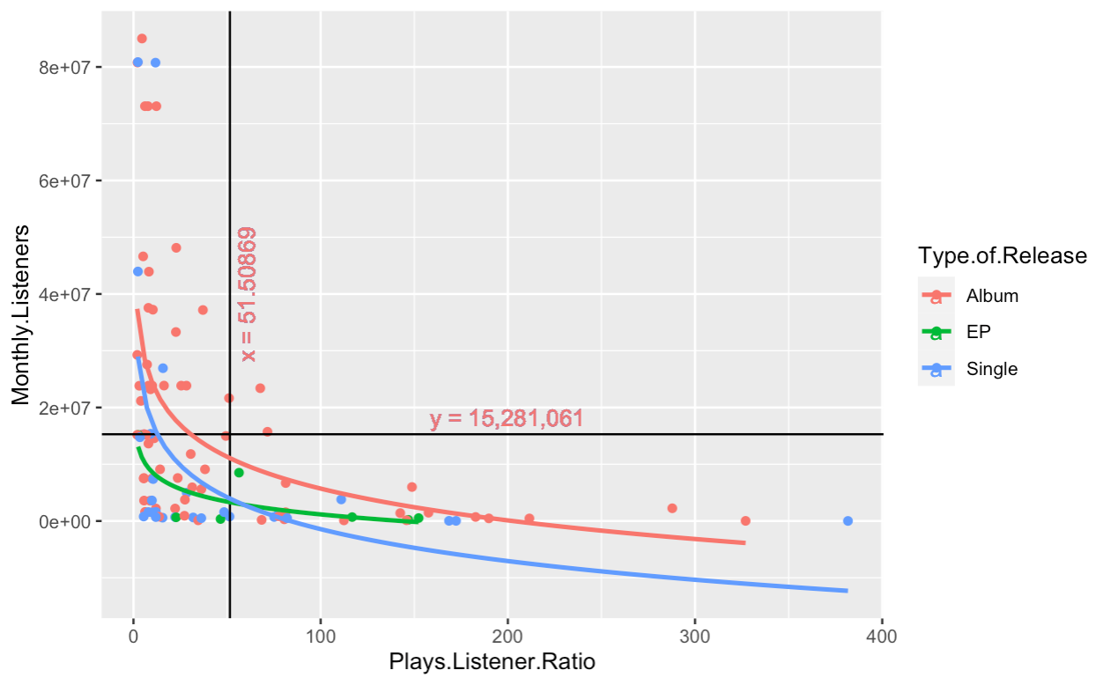
Findings and Visualization
Here is the same graph with the logarithmic fits of each type of release added.
EP: short for extended play, EPs generally contain 3-6 songs and are a cheap alternative to producing an entire album.

Slide 16
Conclusion
We now want to find the 'typical' song in this playlist. We will profile the typical song with a few different characteristics such as most common release day of the week, most common release year, most common artist, genre and duration.

Slide 17
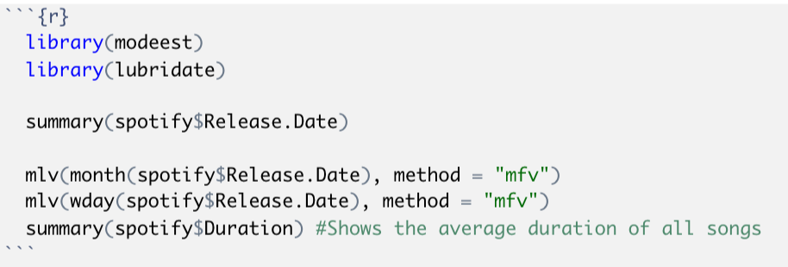
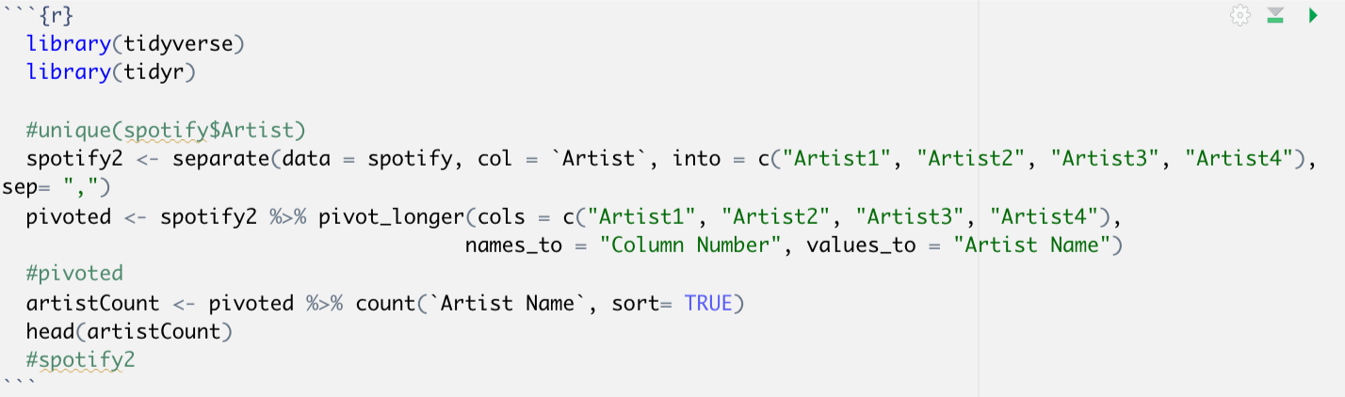
Conclusion
Release Day of Week: Friday
Release Year: 2017
Duration: 3m 23s
Genre: R&B
Artist: blackbear
Release Type: Album

Slide 18

